Slide 1

Presenting By
Srikanth Gude
Anusha Nelluri
Gopi Nelluri
Achyuth Kumar Valeti

Slide 2
Introduction
SAGA Buzz is a one stop website for people interested in Films, TV Series, Celebrity articles, Box Office Collection, and lot more.
Write your own reviews, create your watch list, search your favorite movies, TV Shows and maintain your own movie journal.
All the features will be developed using various web developing tools.

Slide 3
Technologies
HTML
CSS
Type Script
Bootstrap
Angular Framework
TMDB API
Mongo DB
JavaScript

Slide 4
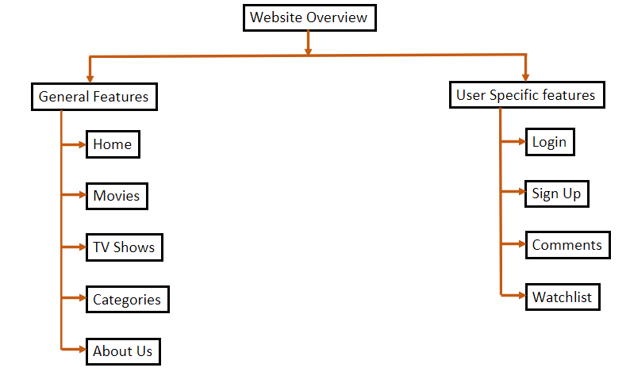
Website Overview

Slide 5
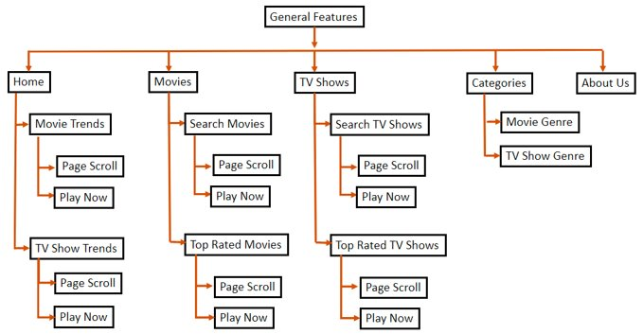
General Features

Slide 6
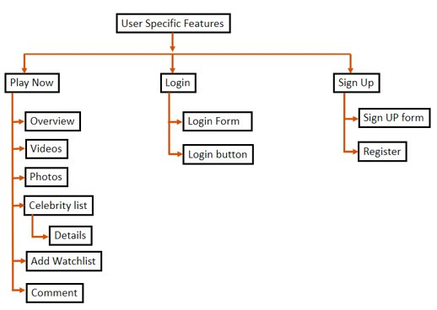
User Specific features

Slide 7
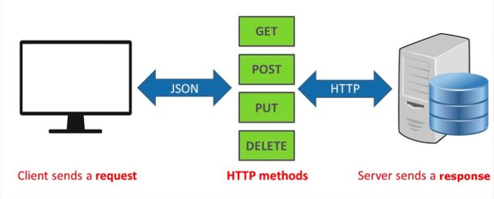
Approach
First, we created our project using Angular framework. Front-end of the page was developed using HTML (Hypertext Markup Language), CSS, Bootstrap.
Then we created respective components, Modules, Services. To store and retrieve the user data we used Mongo DB.
To get information, we used TMDB (The Movie Database) API. Various components are connected to the webpage using Typescript files.
Movie, TV Shows information is fetched from TMDB API. we are using Express JS and developed APIs for User Login, Sign UP, Comments and Watchlist.

Slide 8
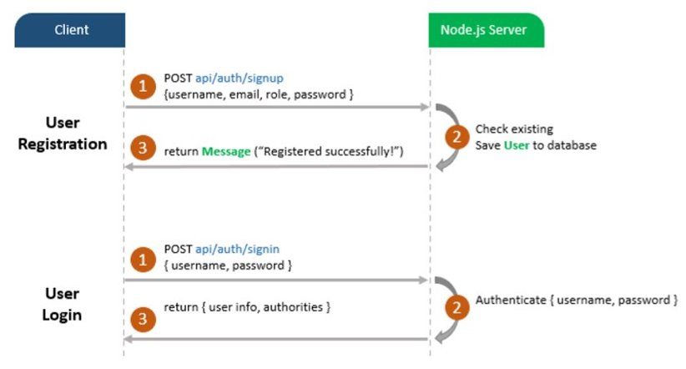
User Registration & Login

Slide 9
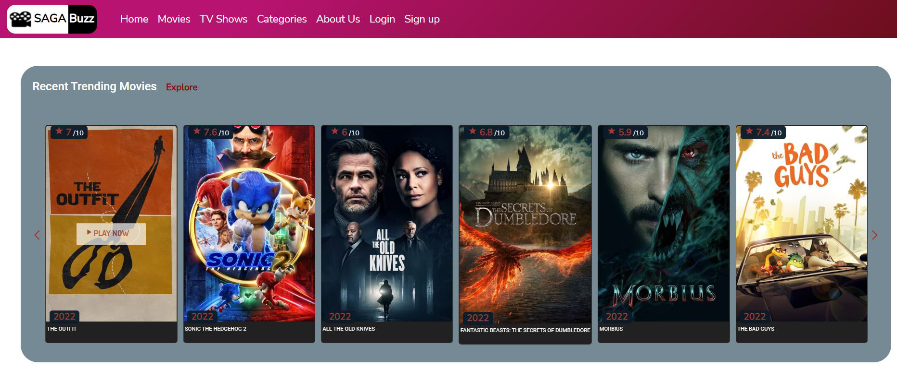
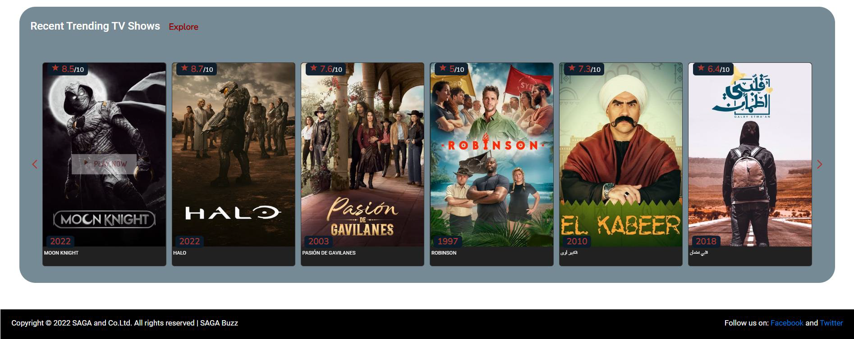
Features
Home will help to see the recent trending Movies; recent trending TV shows and you can see detailed information by using “Play Now”.
You can use scroll “Next/Previous Arrow” to see next or previous movies/Tv Shows. You can use “Explore” to see the full movie/TV Show list.

Slide 10
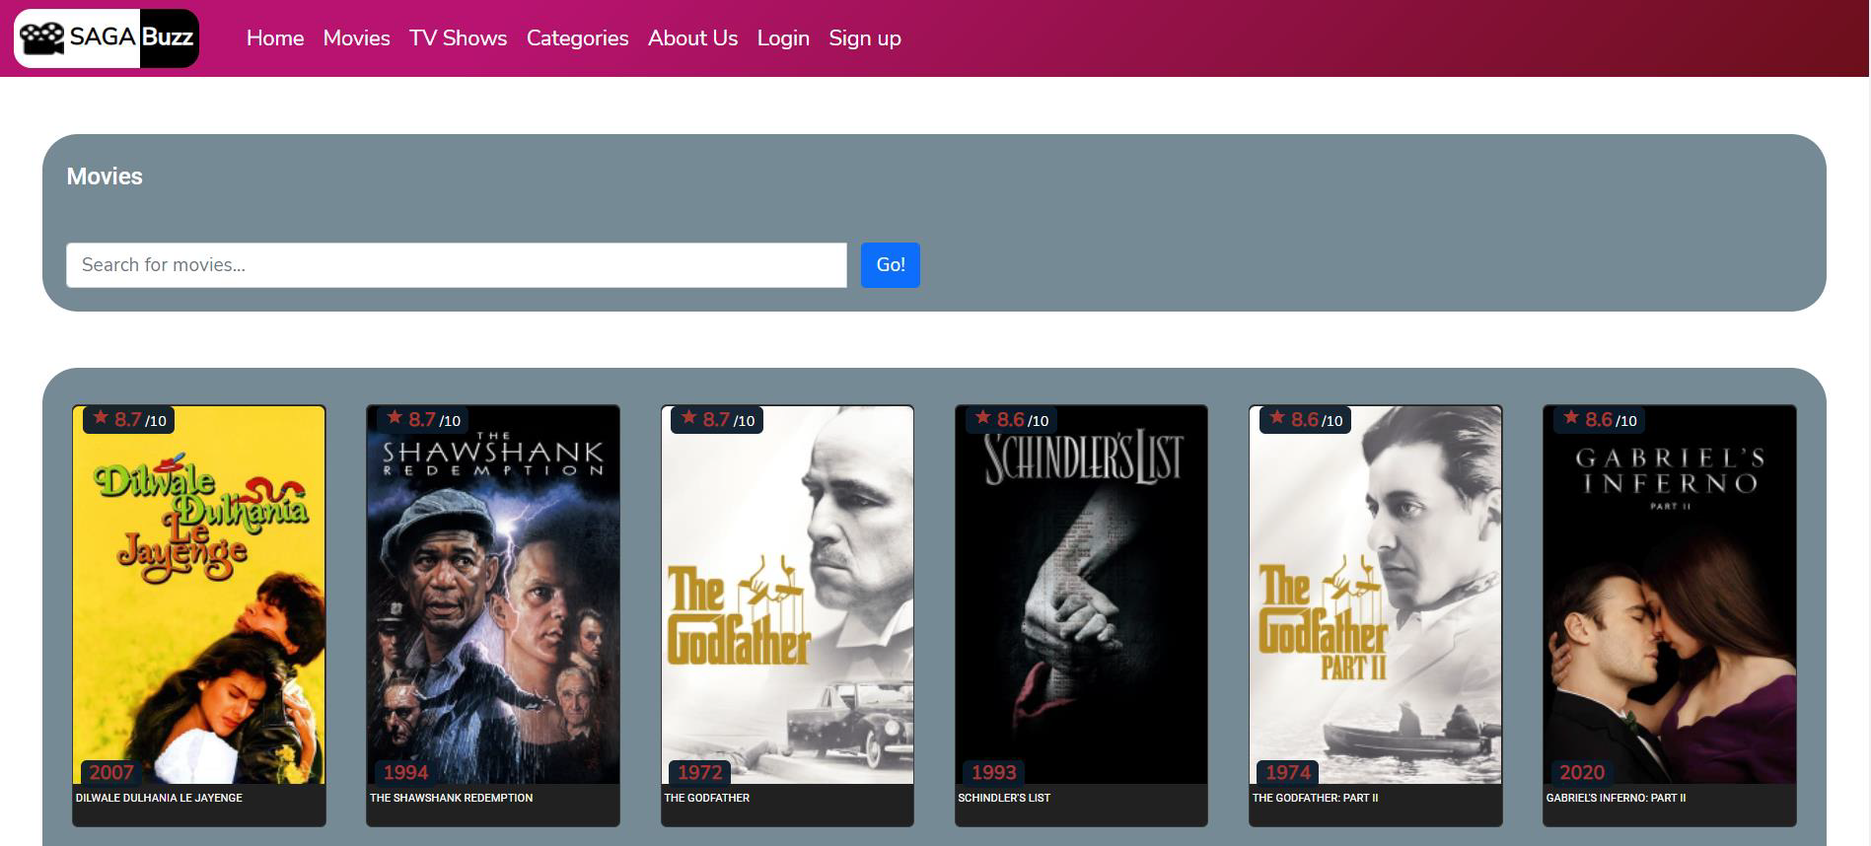
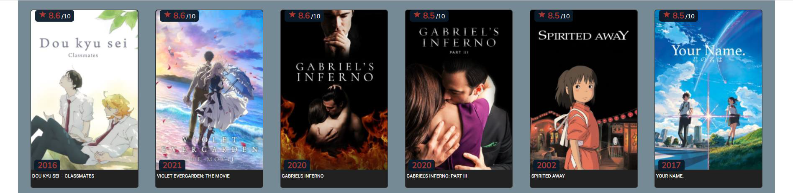
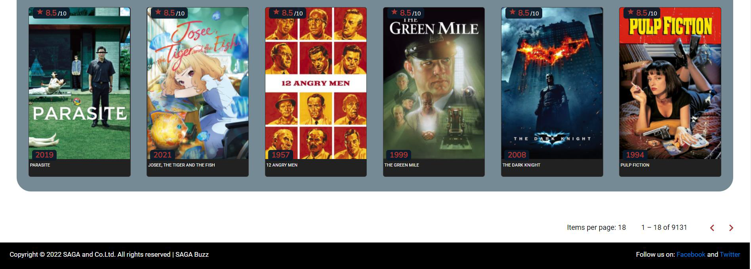
Movies
Movies will help to see the top-rated movies list and can search favorite movie from the list.

Slide 11
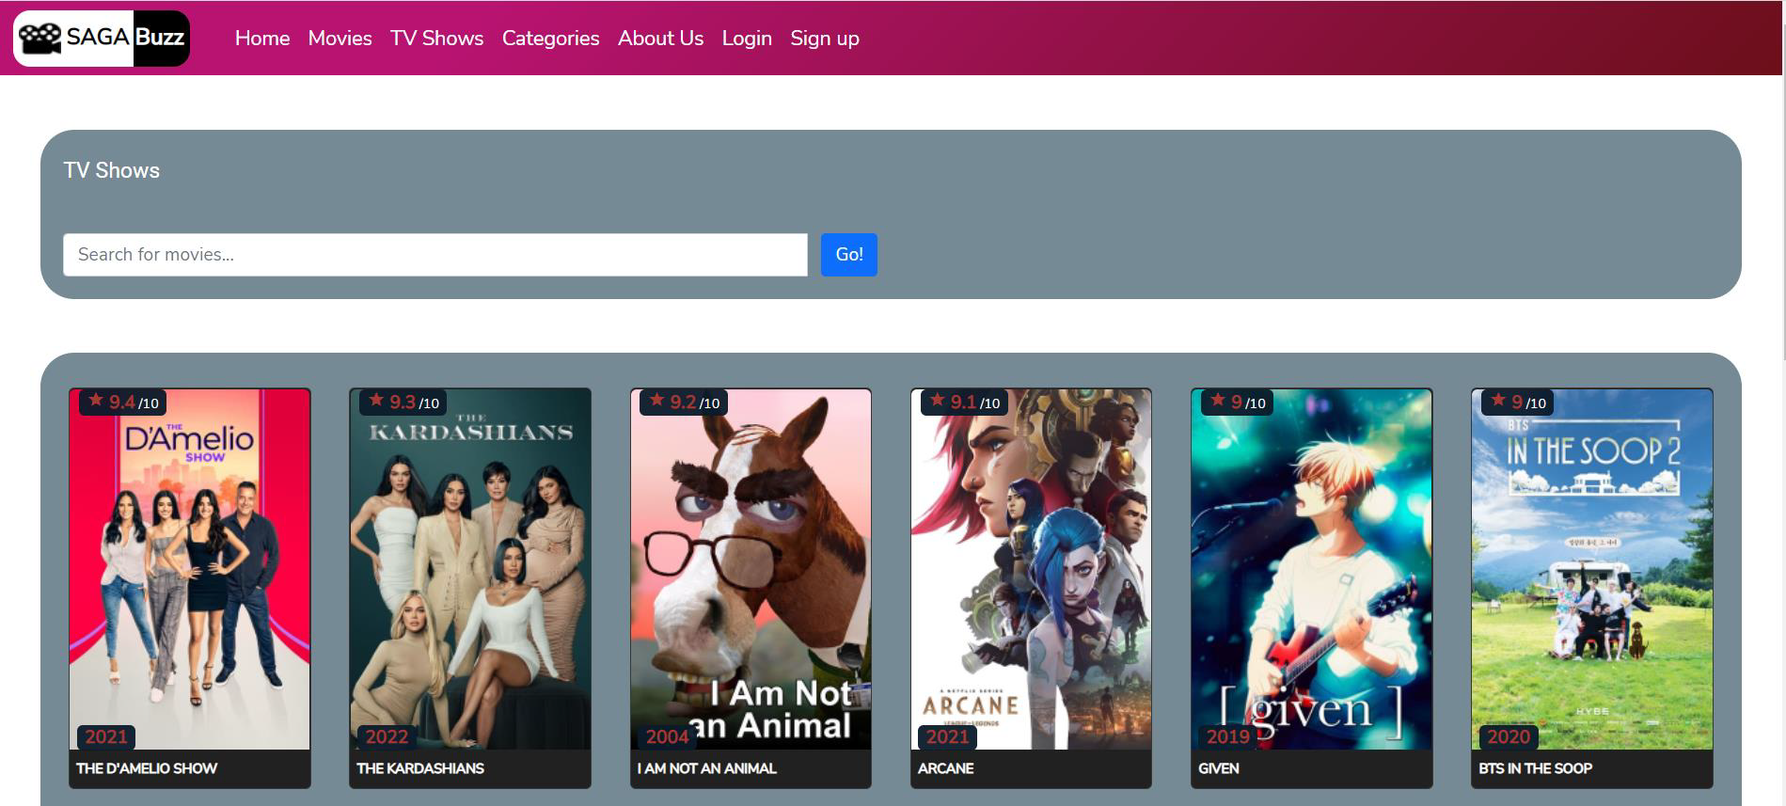
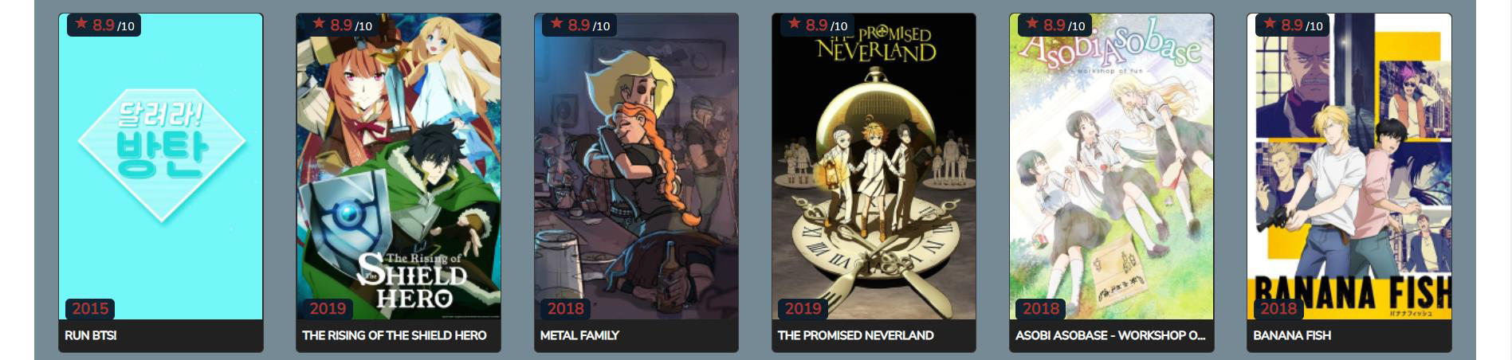
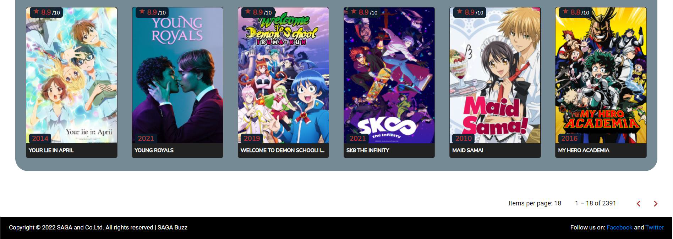
TV Shows
TV Shows will help to see the top-rated TV Shows list and can search favorite TV Show from the list.

Slide 12
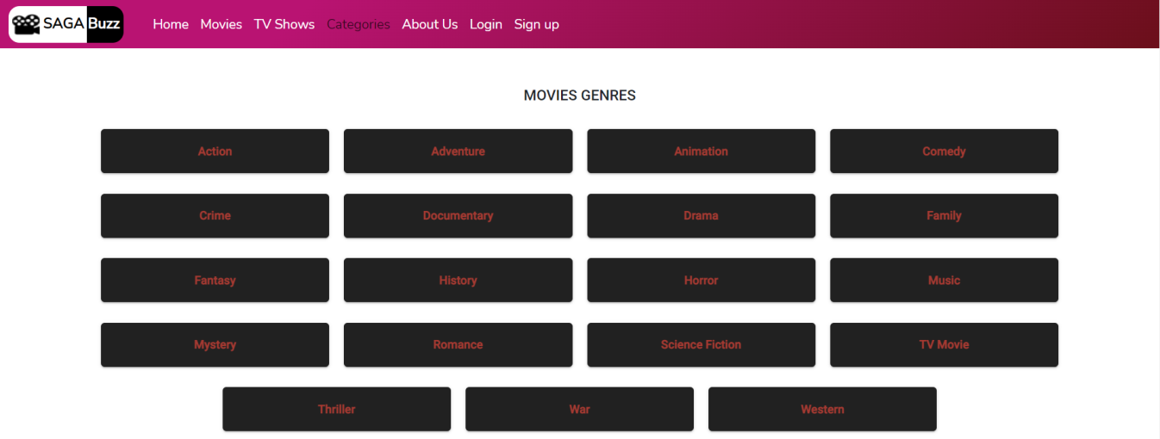
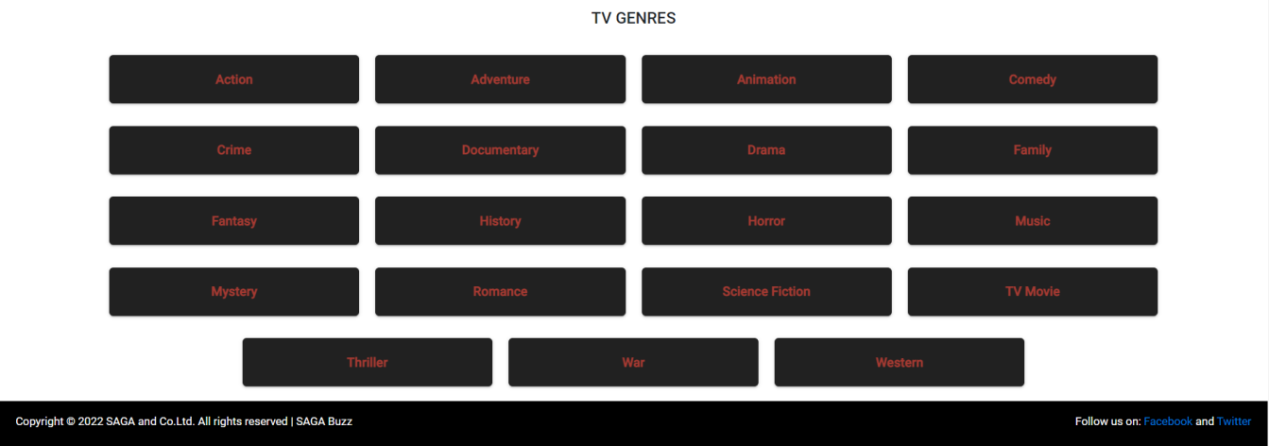
Categories
Categories will help to browse category wise Movies, TV Shows.

Slide 13


About Us
About Us will have the contact information and other details.

Slide 14

Login
Login will help user to login to our webpage.

Slide 15

Sign Up
Sign Up will help user to give their initial details to make their login.

Slide 16
Conclusion
We have implemented the concepts learned in class and from ICP’s
By doing this project we gained hands-on experience about development of webpage from scratch.
Links:
GitHub link: https://github.com/AchyuthValeti/SAGA-Reviews/tree/main
YouTube Link: https://youtu.be/oHn8r0Fhvb8
Presentation Link: https://github.com/AchyuthValeti/SAGA-Reviews/blob/main/WEB_Increment3.pdf

Slide 17
References
https://www.w3schools.com/html/default.asp
https://www.w3schools.com/css/default.asp
https://www.w3schools.com/js/default.asp
https://docs.github.com/en/repositories
https://www.youtube.com
https://www.google.com
https://www.dailywritingtips.com/7-tips-for-writing-a-film-review/
https://en.wikipedia.org/
https://stackoverflow.com/
https://geeksforgeeks.org/
https://www.themoviedb.org/documentation/api
https://getbootstrap.com/docs/5.1/getting-started/introduction/

